Slide 1


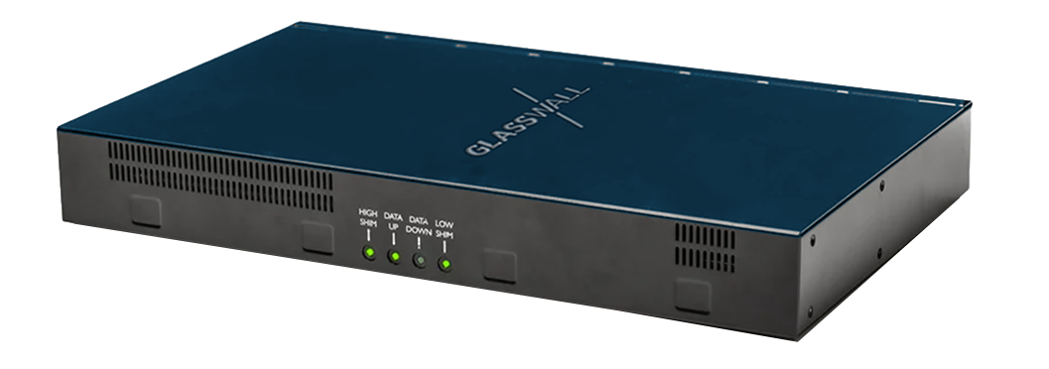
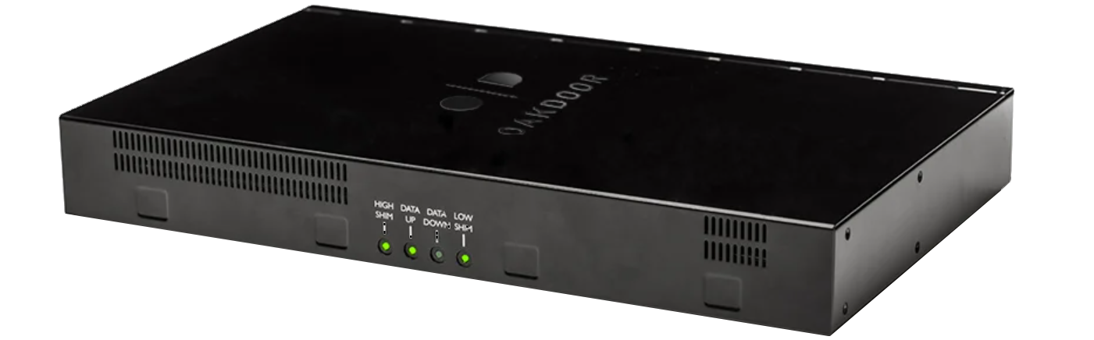

PA Consulting Oakdoor Gateway
Delivering unparalleled CDR performance at scale, Oakdoor Gateway is a hardware security solution that provides secure file import and export to the stringent standards required by government intelligence agencies.
Featuring the file regeneration capabilities of Glasswall’s Rebuild SDK, the Oakdoor Gateway is a cyber security appliance that includes two data diodes and the necessary processing hardware to provide highly controlled unidirectional or bidirectional data flows. It simplifies deployment of low-capacity boundary devices.
The Oakdoor Gateway platform can be used on a desk or mounted in 1U of a 19’’ rack.
The Oakdoor File Gateway offers:
Low CapEx and OpEx
Simple maintenance
Plug and play solution
Single 1U appliance incorporating:
Import Diode
Export Diode
Small form factor “shim” PCs
Shim PCs run software to perform:
Format/protocol conversion
File schema checking
Format/protocol reversion
The Problem
Both government and commercial organisations need to import and export information to and from secure of networks but how can they be assured that risk from this data is minimized?
How Does it Work?
The Oakdoor Gateway incorporates Glasswall’s Rebuild SDK into the shim PCs on both the high and low sides and documents crossing the boundary are deconstructed into text(SISL) and bitmap image representations for content checking then regenerated to the safe standard of 'known good' on the trusted side of the gateway, with the additional ability to search, redact and replace text where required and embed hidden tags into files.
The Solution
The Oakdoor Gateway offers the most comprehensive and cost-effective means to safely import and export information. It enforces the UK National Cyber Security Agency's Safe Data Import and Safe Data Export patterns where Glasswall's engine enhances transformation and verification on files.

Slide 2


Sensitive data
Public data
Secure access
Secure network
Oakdoor
Gateway
Company
low-side network
Firewall
Internet
Cost Breakdown
Year 1
£29,890.00
12 months of Rebuild SDK
Support and maintenance
Year 2
£9,980.00
12 months of Rebuild SDK
Support and maintenance
Year 3
£9,980.00
12 months of Rebuild SDK
Support and maintenance
Diode throughput
Secure internet browsing & shared desktop access
Secure file transfer (including large files)
Security Enforcing Functions
Up to 1 Gbit/s
Via Safe Browse software (included)
Via Safe Data software (included)
Protocol conversion
Reliable file transfer
File re-wrapping
File routing
Operating temperature range
Dimensions
Weight
Power
Warranty
0-30 °C
350 x 210 x 44 mm
2500 g
100-240 VAC 50 W
1-year hardware warranty
sales@glasswallsolutions.com
www.glasswallsolutions.com

